Slide 1



California Healthcare Analysis
Project Summary

Slide 2

Group 6- Healthcare Analysis
Introduction Of Group Members:
1.Kajal Jain
2.Roshan Sharma
3.Sneha Pillai
4.Sheenu Yaduvanshi

Slide 3
Healthcare is a critical domain where data plays pivotal role in understanding Patient Demographics, Medical conditions, and the effectiveness of Healthcare services, Financial ratios which affect the Industry
Dataset provided to us was from year 2016 to 2019 and included Patient Information, City wise Information ,Bed Availability, Financial Information of different types of Hospitals in State of California in USA
The primary goal of this project is to explore, clean, and visualize the data to gain insights into healthcare trends and understand the distribution of medical conditions.

Slide 4
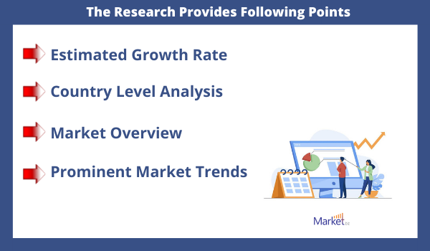
Revenue and Expenses Key Card and Trend Lines
Total Patient Days, Total Patient Discharges, Bed Availability
Data Distribution as per City, County, CEO wise
Hospital wise Analysis
From Year 2016- 2019

Slide 5

Overview of Data Analysis
Key Positives and Negatives

Slide 6
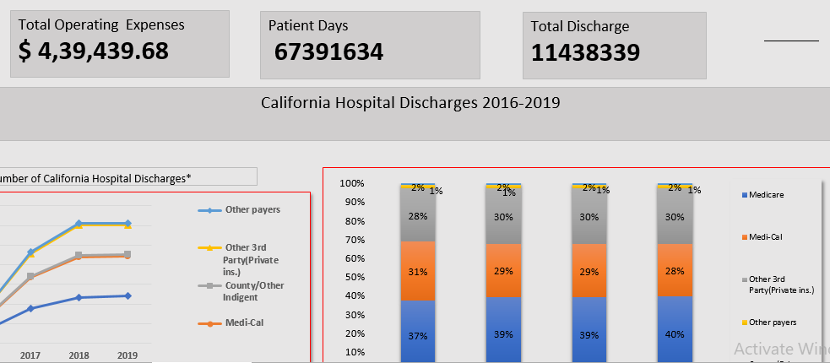
Excel Dashboard

Slide 7

Positives:
With Data being huge and tedious we used Power Query to arrive at our KPI
We uploaded Data in PowerQuery and created Charts and Reports
We created interactive Charts like Bar chart ,Stacked Bar chart, Pie Chart for data
Our KPI’s show Total Doctors, Total Patient days , Total Discharge, Revenue Figures across 4 years – 2016 to 2019
With the help of Excel Formula we calculated Percentage change on YOY basis
Negatives:
Since data was huge we were unable arrive at certain Calculations like Average Length of Stay
Dashboard was less interactive as compared to Tableau and PowerBi Dashboards

Slide 8
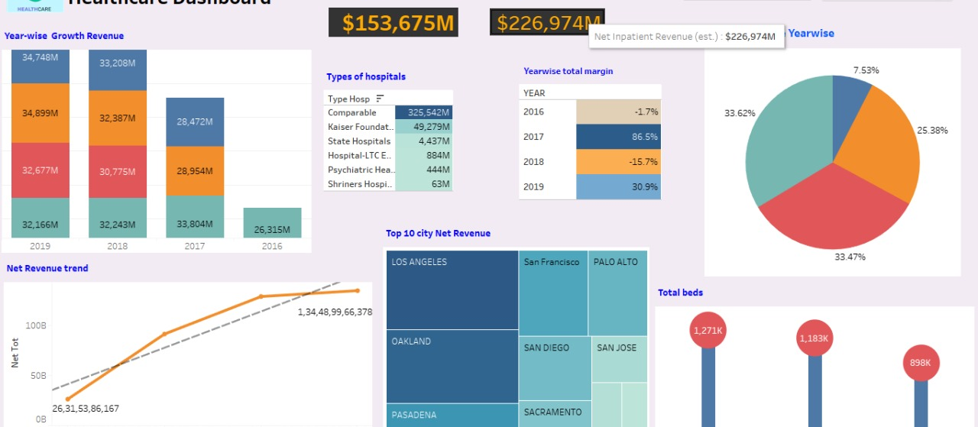
Tableau Dashboard

Slide 9
Positives:
In tableau Data in sheets and dashboards is connected; when you modify a sheet, any dashboards containing it change, and vice versa
We created sheets for different KPIs and pulled them in Dashboard
We created Parameters and Calculated Fields to arrive at KPIs
For Revenue Trends we used a Line chart and Tree map to map top 10 revenue generating cities
We used interactive visualizations like Lolipop Chart, Pie chart and Tables
We also inserted Filter feature for data analysis
Easier to arrive at Financial Ratios as compared to Excel
Negatives:
1. There was no automatic refreshing of Reports

Slide 10
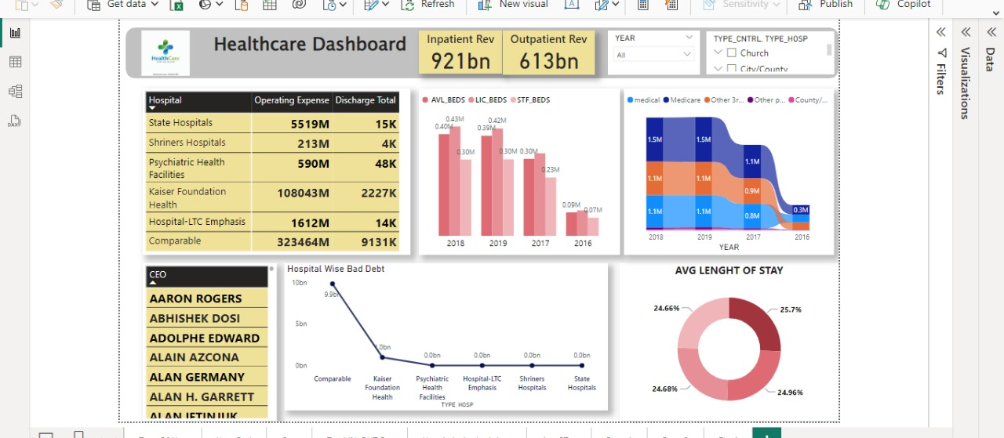
Power BI Dashboard

Slide 11
Positives:
Power BI Dashboard is a single page that tells a story, a well designed dashboard only contains Highlights of the story
We used Power Query editor to join the table and clean the data to remove undesirable columns
We also created/added New Columns to create a Measure in Power BI
In Power BI we could easily arrive at Average Length of Stay values
We used Stacked Bar Chart to show the Average Length of Stay
We used Slicer to show the data across years and Types of Hospitals
7. We used interactive charts like Ribbon chart, donut chart, Matrix to show the data effectively
Negatives:
1.Data Quality – Large Volume of data creates issues
2.Performance issues

Slide 12

Key Takeaways:
For dataset of Health Care Analysis Our team feels Power Bi is convenient to work with:
We could easily analyse given Dataset with Power Bi
DAX calculation features helped to arrive at Average financial workings to provide insights
Data Visualisations which we used were more Interactive , Easy to Apply and Understand
Slicer feature on Dashboard makes data analysis relevant and easy to explain
1.Tableau in Comparison to Power BI was slightly difficult for calculation purpose which also proved to be
time consuming
1.Advanced Excel was very time consuming tool for large and multiple data files as we faced issues while
joining tables, applying formula

Slide 13
THANK YOU
ROSHAN SHARMA

